Slide 1


EECS 6690 SL for Bio & Info
A Comparative Study on the Adults Dataset
using Different Machine Learning Methods
Yunhang Lin (yl4860) Zhuoyu Feng (zf2272) Xiaoyue Chen (xc2551)
Xintong Liu (xl3121)

Slide 2


Presentation Outline
Introduction
Exploratory Data Analysis
Data Exploration
Data Cleaning
Data Visualization
Reproduction
Naive-Bayes
C4.5
NBTree
Innovation
XGBoost
LightGBM
Conclusion And Future Work

Slide 3

Introduction
The Necessity to predict the income of population
For individuals:
Find ways to promote it
Improve life quality
For merchants:
Help to identify target customer
Make marketing strategy
Income is a privacy of human right
Hard to get it directly

Slide 4

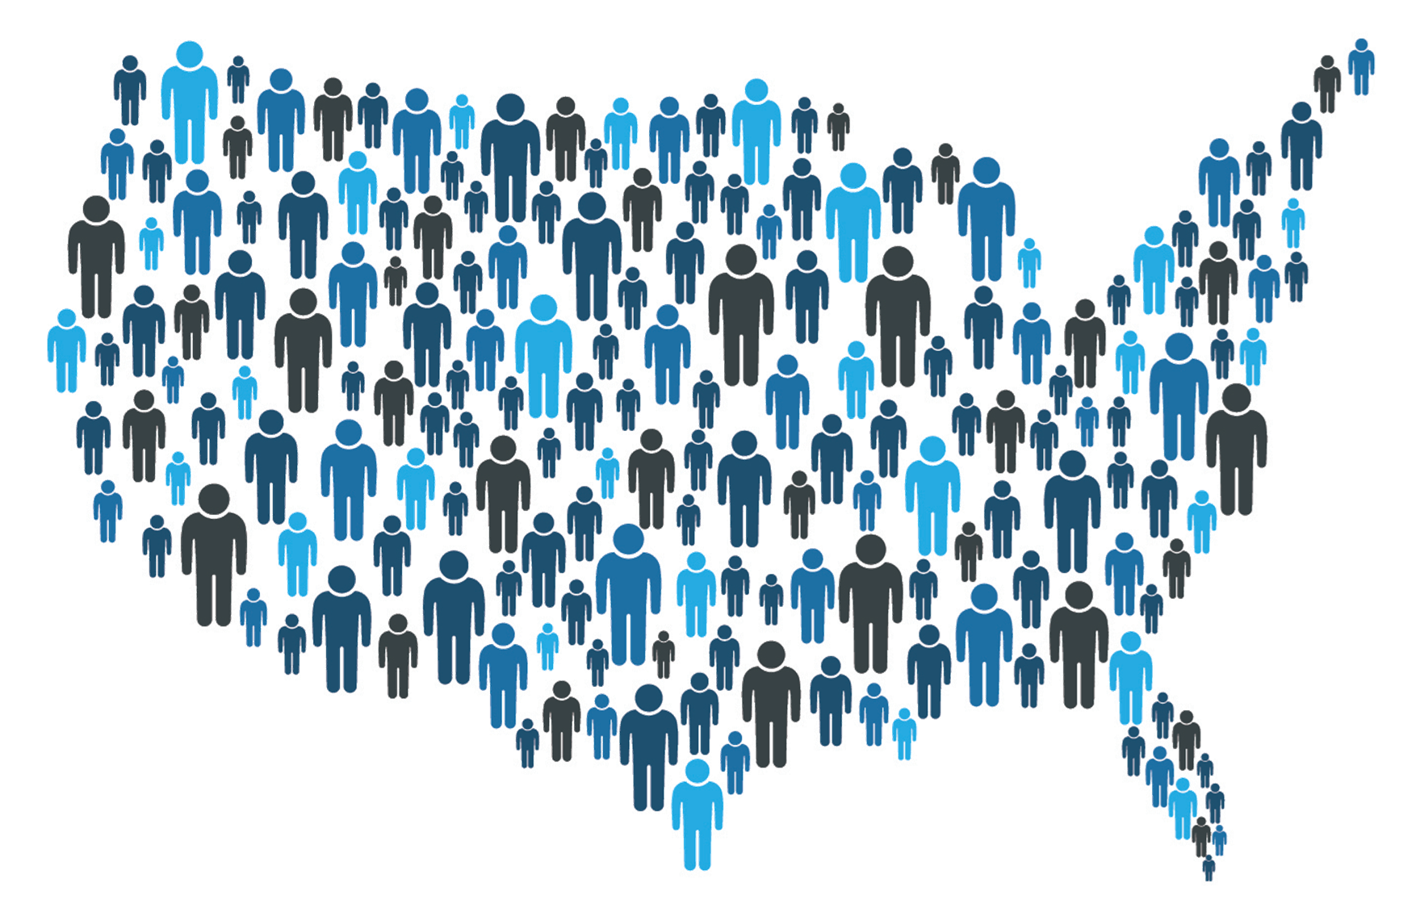
Dataset Description
Adult Data Set^{[1]}
Extracted by Barry Becker from the 1994 Census database
Used for categorization forecasting
whether an individual earns more than 50K a year
Donated by Ronny Kohavi and Barry Becker
The dataset contains 48,842 instances
45222 instances if unknown values are dropped.
6 duplication instances
14 attributes -> 1 target
[1] Dua, D. and Graff, C. (2019). UCI Machine Learning Repository [http://archive.ics.uci.edu/ml]. Irvine, CA: University of California, School of Information and Computer Science.

Slide 5
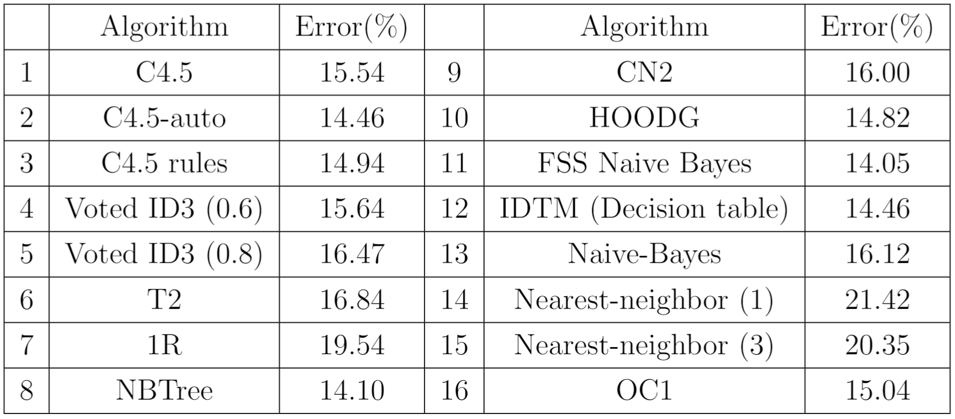
Question define and works review
First cited by Ron Kohavi^{[2]}
Proposed a new algorithm NBTree
Combination of decision-tree and Naive-Bayes
O(m logm) complexity
Perform well for large databases
Other strategy also mentioned in other works, like SVM, KNN, Bagging, Random forest, etc.
It is a Binary Classification
[2] Kohavi, Ron. "Scaling up the accuracy of naive-bayes classifiers: A decision-tree hybrid." Kdd. Vol. 96. 1996.

Slide 6
Exploratory Data Analysis
Data Exploration
Number of Instances | 48843 | Number of Attributes | 14
Data Type | Numerical (integer), Categorical | Number of Numerical Attributes | 6
Number of Categorical Attributes | 8 | Associated Tasks | Supervised ML - Classification
Target Variable | Income | Missing Values? | Yes

Slide 7
Exploratory Data Analysis
Data Cleaning - Factors Combining
workclass
”Without-pay”, ”Never-worked” ”Unemployed”
”State-gov”, ”Local-gov” ”SL-gov”
”Self-emp-inc”, ”Self-emp-not-inc” ”Self-employed”
marital-status
”Married-AF-spouse”, ”Married-civ-spouse” and ”Married-spouse-absent”
”Married”
”Divorced”, ”Separated” and ”Widowed” ”Not-Married”
native-country:
… “North America”
… “Asia”
… “South America”
… “Europe”
… “Other”

Slide 8
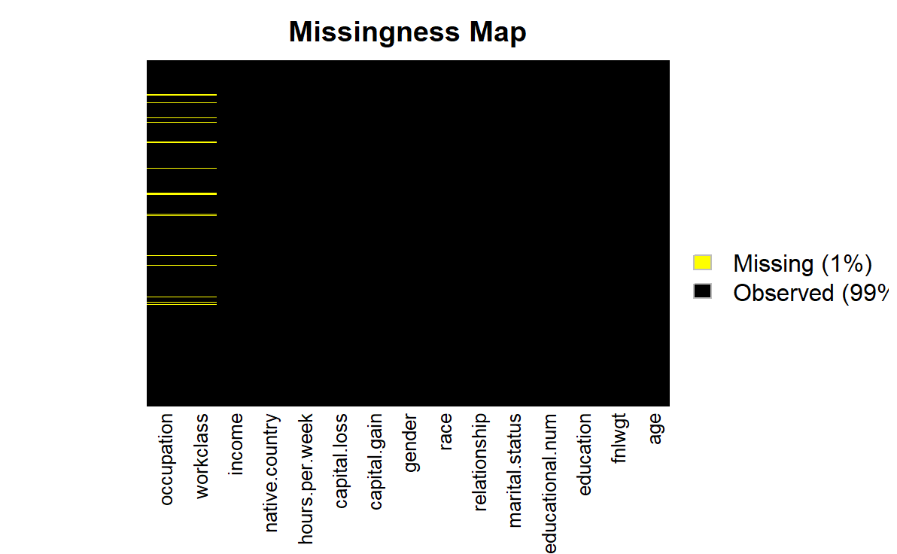
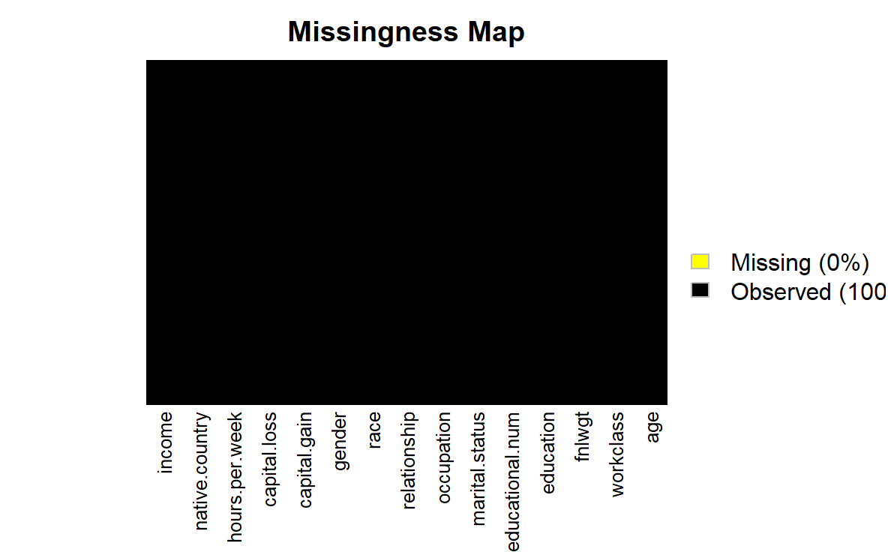
Exploratory Data Analysis
Data Cleaning - Dealing with Missing Data
Dropping rows with missing values

Slide 9
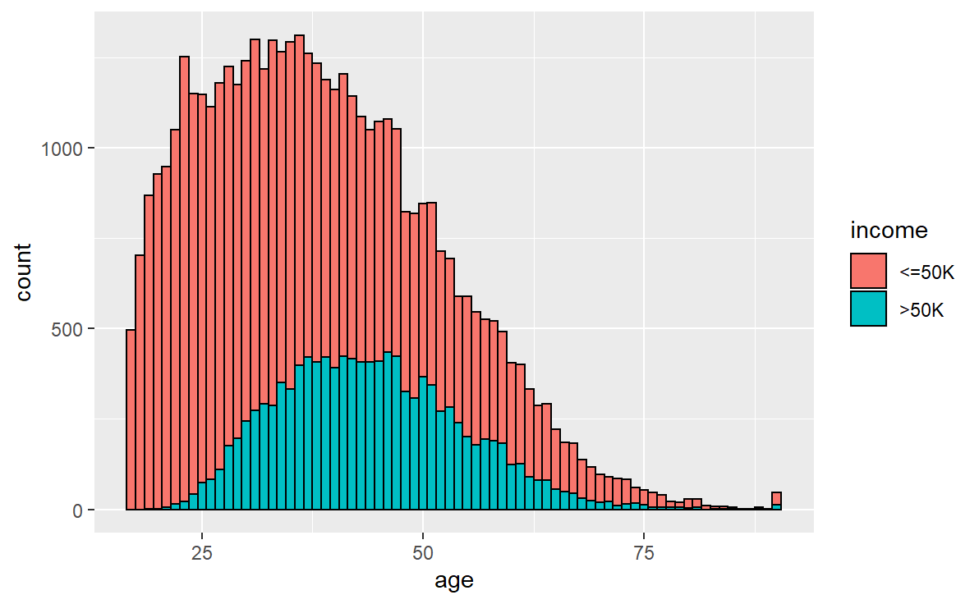
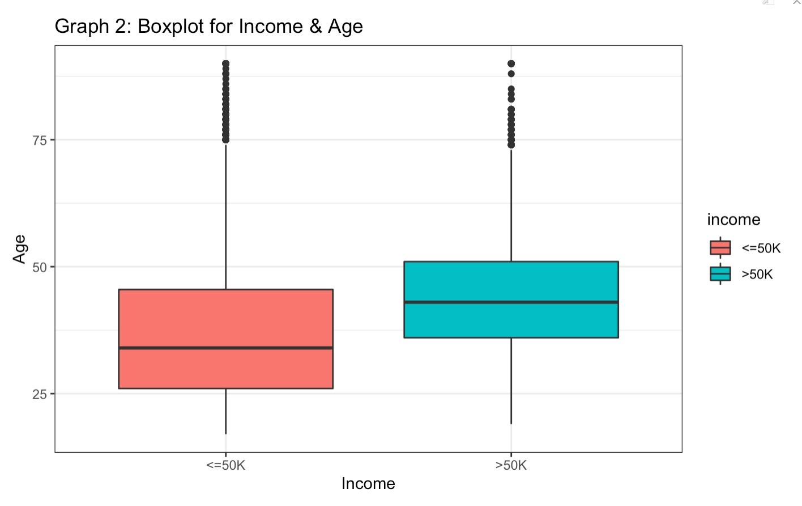
Exploratory Data Analysis
Data Visualization

Slide 10
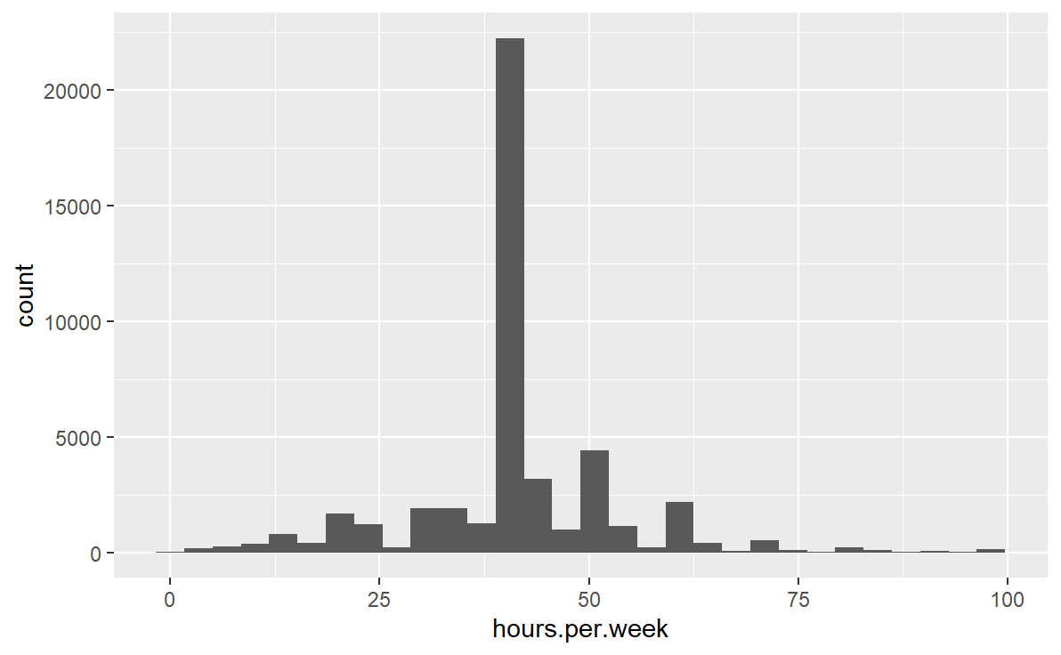
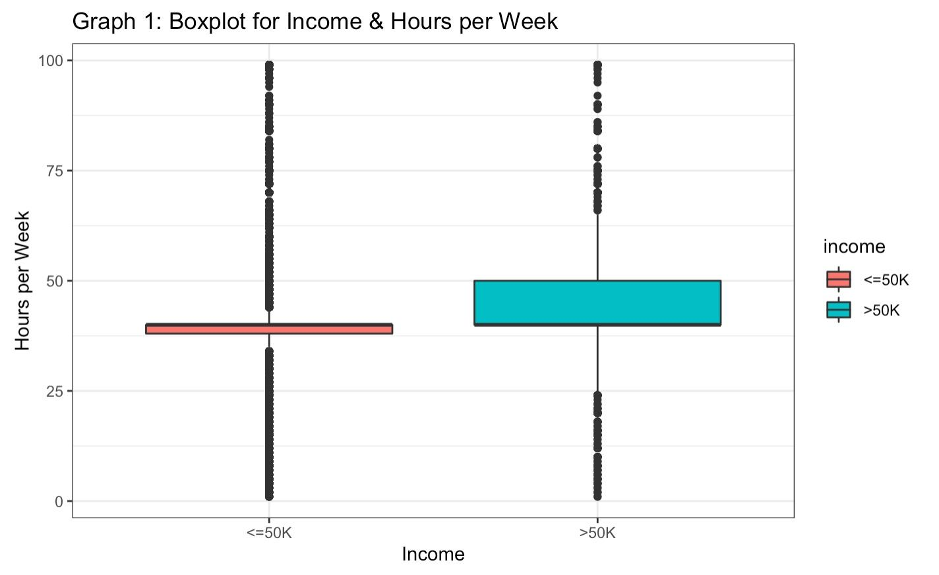
Exploratory Data Analysis
Data Visualization

Slide 11
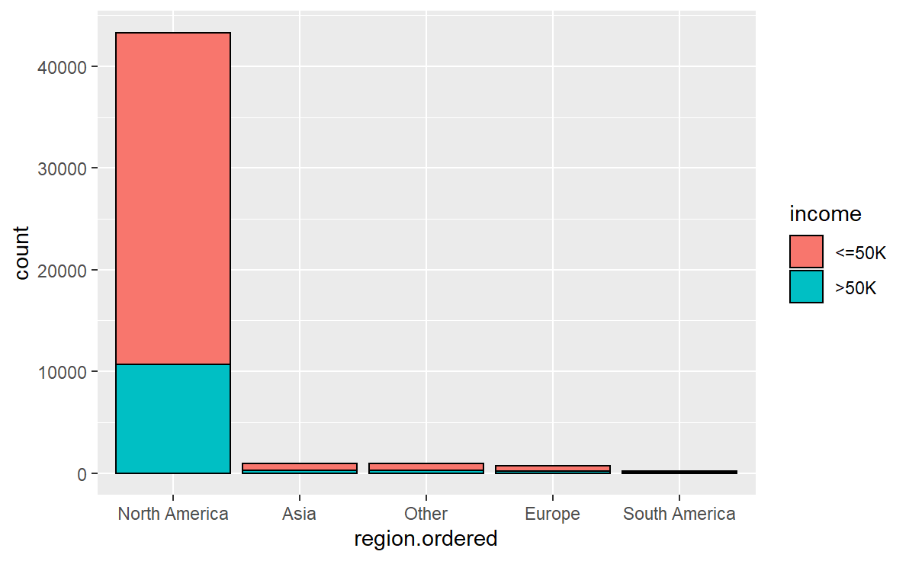
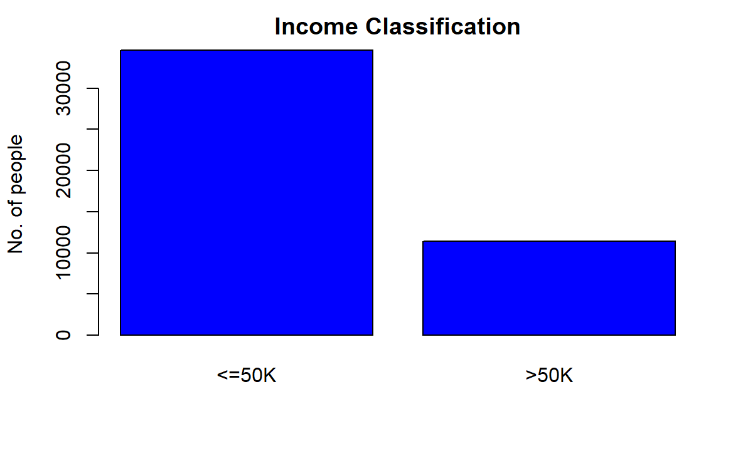
Exploratory Data Analysis
Data Visualization

Slide 12
Reproduction: Naive-Bayes & C4.5 & NBTree
Naive-Bayes:
most studies were done on small databases
C4.5:
Algorithm used to generate decision tree
Naive-bayes does not scale up as well as decision tree in large databases
NBTree:
Hybrid of decision tree and Naive-Bayes
Split as regular decision tree
But leaves are replaced by Naive-Bayes
1
2
1
2

Slide 13
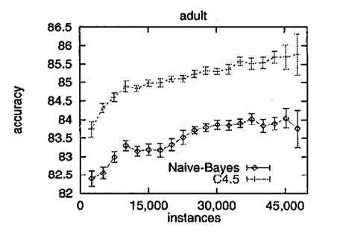
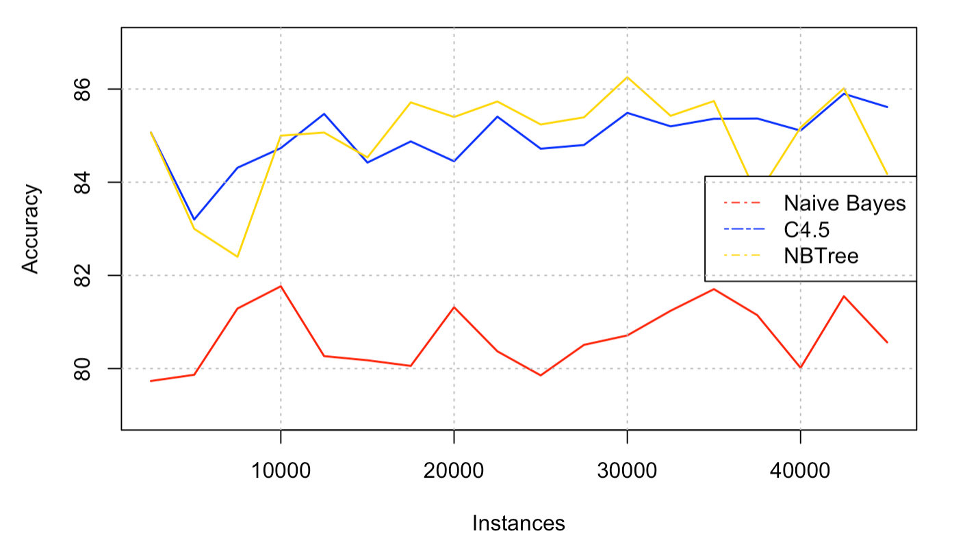
Reproduction: Naive-Bayes & C4.5 & NBTree
NBTree & C4.5 around 3% better than Naive-Bayes in accuracy
In most cases: NBTree > C4.5 > Naive-Bayes

Slide 14
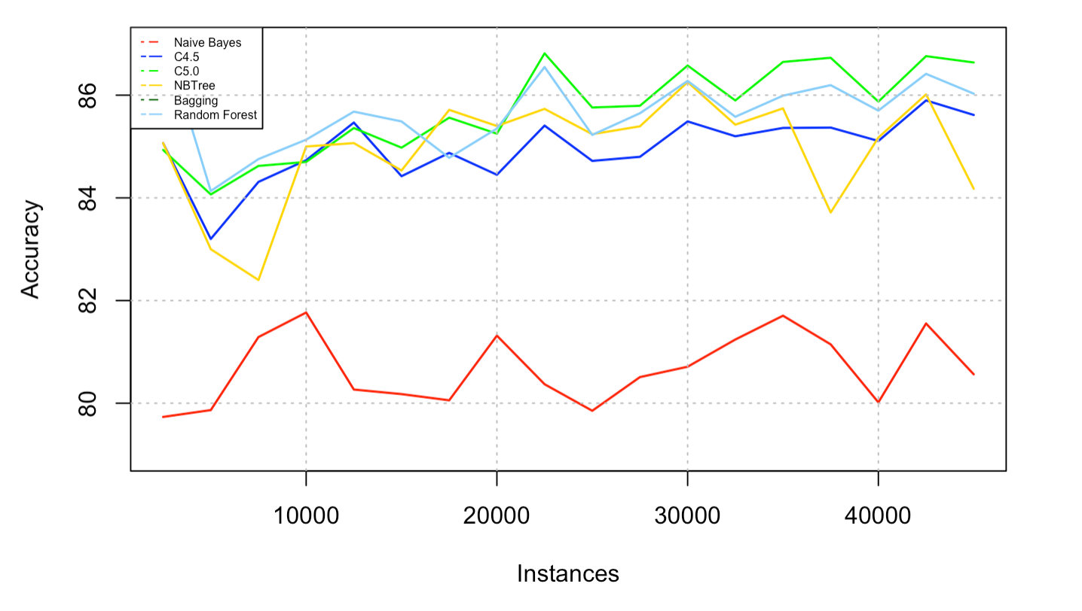
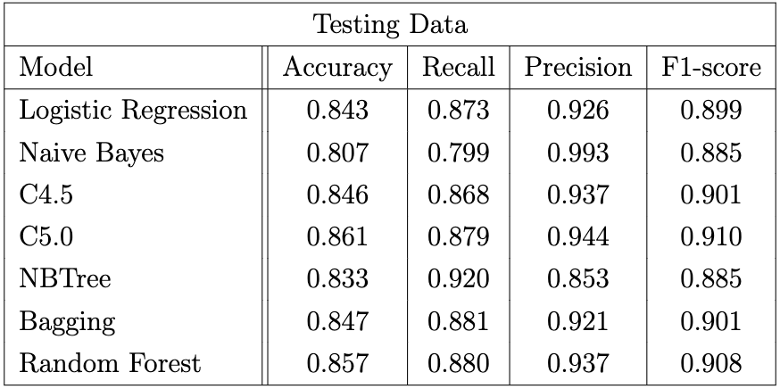
Reproduction: Naive-Bayes & C4.5 & NBTree
Other models: C5.0, Random Forest, Bagging, Logistic Regression

Slide 15
Other methods: LightGBM & XGBoost
Metric
Model | Accuracy | Recall | Precision | F1-score
XGBoost | 0.873 | 0.938 | 0.900 | 0.918
LightGBM | 0.865 | 0.936 | 0.892 | 0.913
XGBoost has a better performance than LightGBM

Slide 16
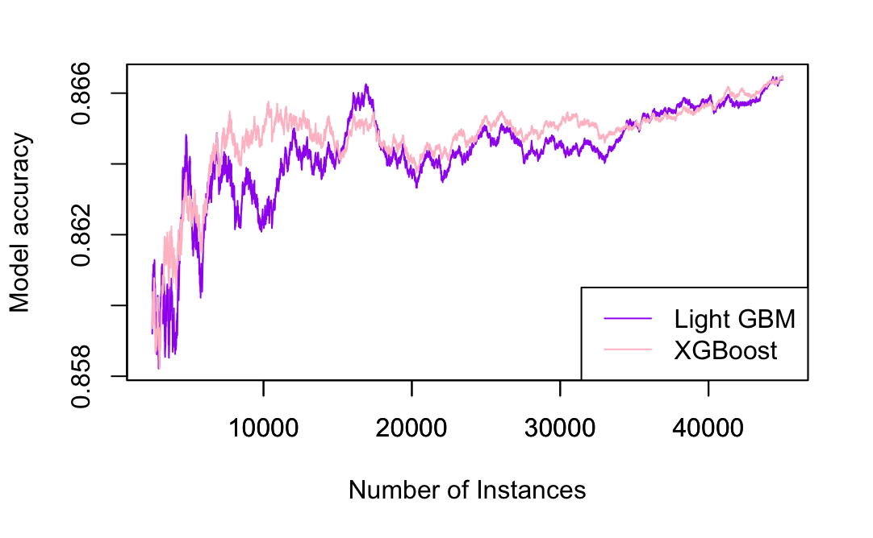
Other methods: LightGBM & XGBoost
Accuracy with # of instances
XGBoost is more stable
Accuracy nearly the same when the size of the instances is large

Slide 17
Other methods: LightGBM & XGBoost
Why?
XGBoost
LightGBM
Level-wise growth
is capable of building more robust models
Leaf-wise growth
more loss reduction
may overfitting

Slide 18

Conclusion
Total 7 models reproduced
Logistic Regression, Naive Bayes, C4.5 decision tree, C5.0 decision tree, NBTree, Bagging, and Random Forest.
Implemented 2 novel strategies
XGBoost and LightGBM
Optimal evaluation data
87.3% accuracy @ XGBoost
93.8% recall @ XGBoost
99.3% precision @ Naive Bayes
0.918 F1-score @ XGBoost
XGBoost and LightGBM generally perform better than models in papers

Slide 19
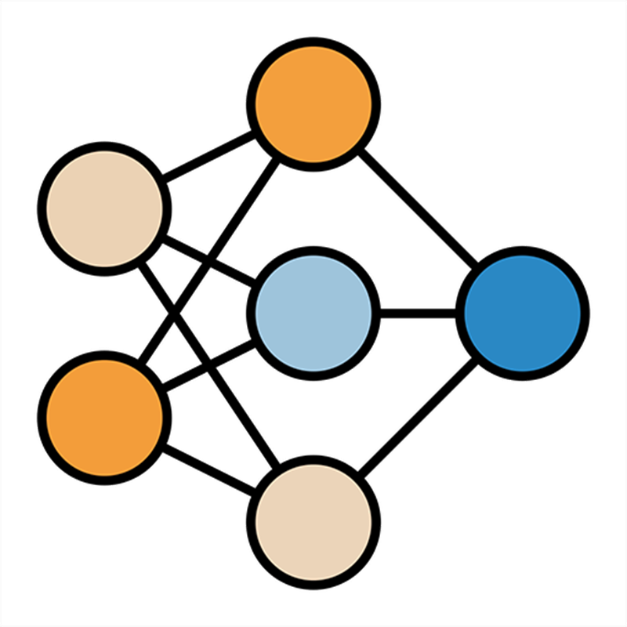
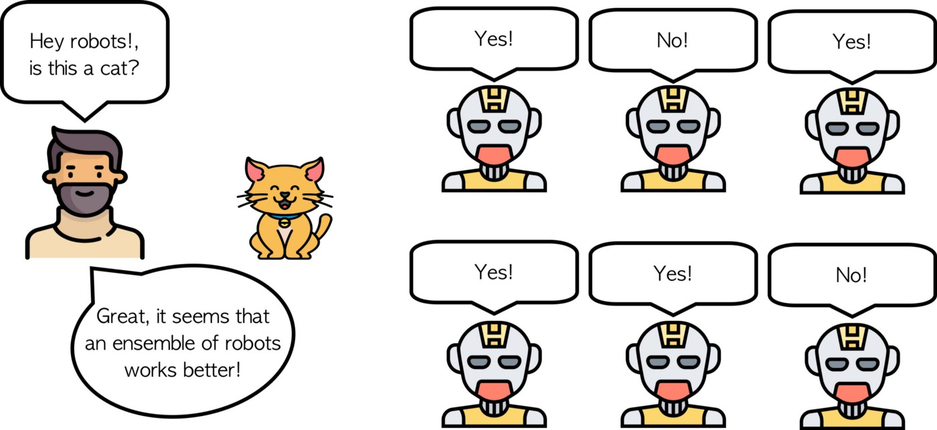
Future Work
Eliminate the bias in the dataset to keep more balanced inputs.
Deploy and fine-tune neural networks.
Model ensemble to synthesize the advantages of all models

Slide 20
Reference
[1] Rich Caruana and Alexandru Niculescu-Mizil. “An Empirical Evaluation of Supervised Learning for ROC Area.” In: ROCAI. 2004, pp. 1–8.
[2] Rich Caruana et al. “Ensemble selection from libraries of models”. In: Proceedings of the twenty-first international conference on Machine learning. 2004, p. 18.
[3] Jes ́us Cerquides and Ramon L`opez de M`antaras. “Maximum a posteriori tree augmented naive Bayes classifiers”. In: International Conference on Discovery Science. Springer. 2004, pp. 73–88.
[4] Tianqi Chen and Carlos Guestrin. “XGBoost: A scalable tree boosting system”. In: 22nd ACM SIGKDD International Conference on Knowledge Discovery and Data Mining. 2016, pp. 786–794.
[5] James Dougherty, Ron Kohavi, and Mehran Sahami. “Supervised and unsupervised discretization of continuous features”. In: Machine learning proceedings 1995. Elsevier, 1995, pp. 194–202.
[6] Wei-Chun Kao et al. “Decomposition methods for linear support vector machines”. In: Neural Computation 16.8 (2004), pp. 1689–1704.
[7] Guolin Ke et al. “Lightgbm: A highly efficient gradient boosting decision tree”. In: Advances in neural information processing systems 30 (2017).
[8] S Sathiya Keerthi and Chih-Jen Lin. “Asymptotic behaviors of support vector machines with Gaussian kernel”. In: Neural computation 15.7 (2003), pp. 1667–1689.
[9] Ron Kohavi et al. “Scaling up the accuracy of naive-bayes classifiers: A decision-tree hybrid.” In: Kdd. Vol. 96. 1996, pp. 202–207.
Thank you for the listening!

